Slide 1
University of Warsaw
Faculty of Political Science
and International Studies

Slide 2
University of Warsaw
Founded in 1816
University of Warsaw is among the top 3% of the world’s best universities (Shanghai Ranking)
The largest University in Central Europe
46 000 students
3 200 doctoral students
7 200 employees, including
3 700 academic teachers
4 Doctoral Schools

Slide 3
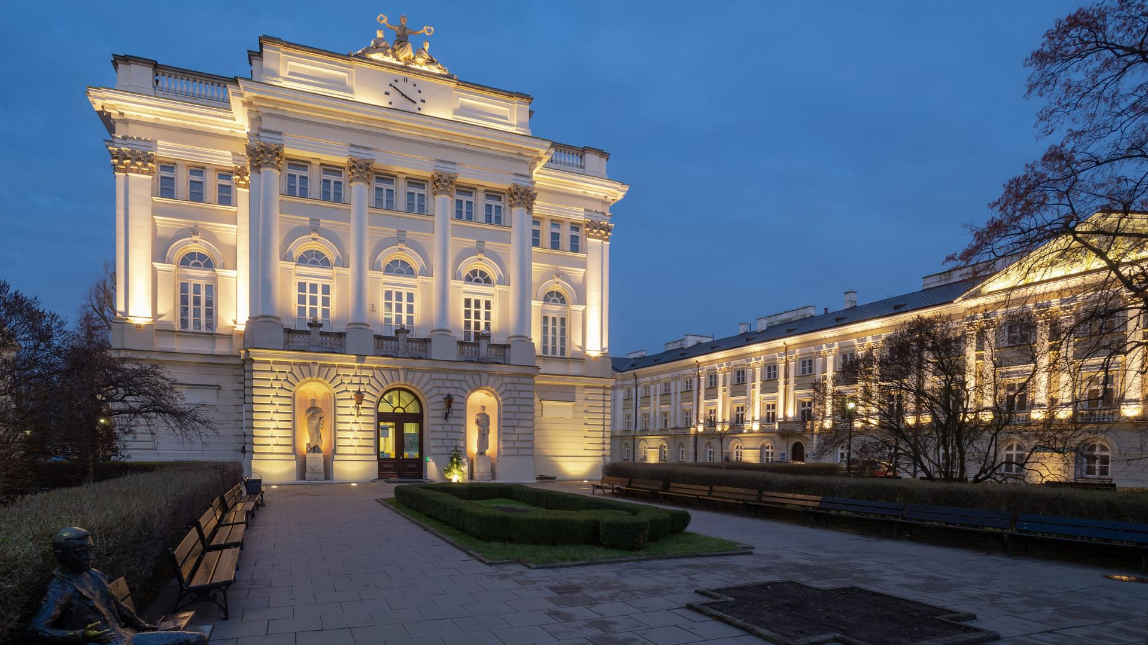
University of Warsaw
6 Noble Prizes (Olga Tokarczuk in 2019)
24 Faculties and over 30 Research Units
Cooperation with over 800 foreign entities
1 600 scientific projects financed with Polish and international grants

Slide 4
University of Warsaw
Over 100 BA/MA programmes
27 English-language programmes
120 postgraduate programmes (ie. MBA, LLM)
10 000 outgoing students per year

Slide 5
Faculty of Political Science and International Studies
The biggest number of foreign students in Poland
The largest Faculty at the University of Warsaw
Located in the heart of Warsaw Old Town
More than 200 agreements with universities worldwide

Slide 6
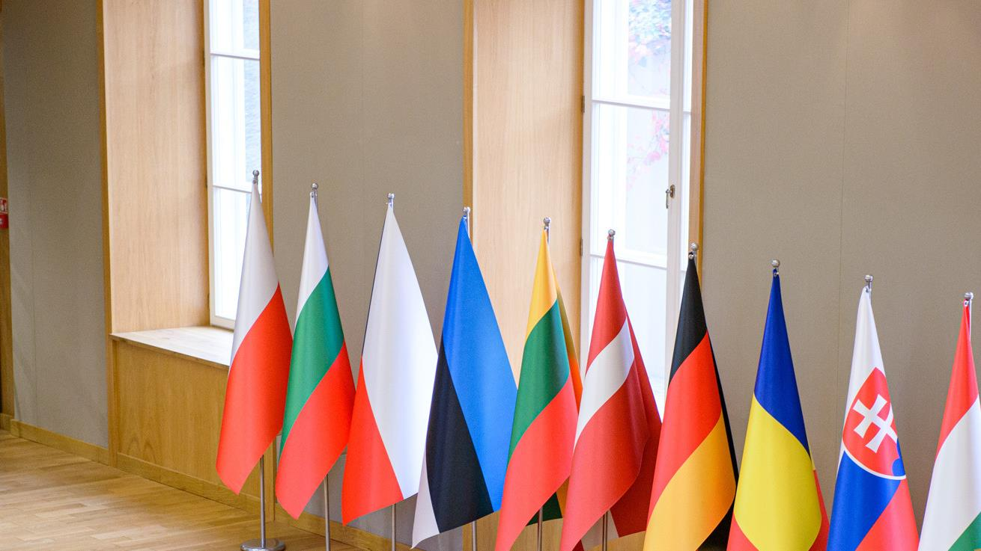
5 fields of research
at the Faculty:
Political Science
International Relations
Social Policy
European Studies
Internal Security

Slide 7
Faculty structure
Department of Regional and Global Studies
Department of Strategic Studies and International Security
Department of Diplomacy and International Institutions
Department of Methodology of Political Science
Department of Internal Security
Department of Information Technology
Department of Labor System and Labor Market
Department of Social Policy
Department of Political History
Department of Political Theory and Political Thought
Department of Political Sociology and Political Marketing
Department of Political Systems
Department of State Sciences and Public Administration
Department of European Union Policies
Department of Law and European Union Institutions
Department of Eastern Studies

Slide 8
Faculty Scientific Journals
International Relations
“Stosunki Międzynarodowe”
European Review
“Przegląd Europejski”
Social Policy Issues
“Problemy Polityki Społecznej”
Political Science Studies
“Studia Politologiczne”

Slide 9
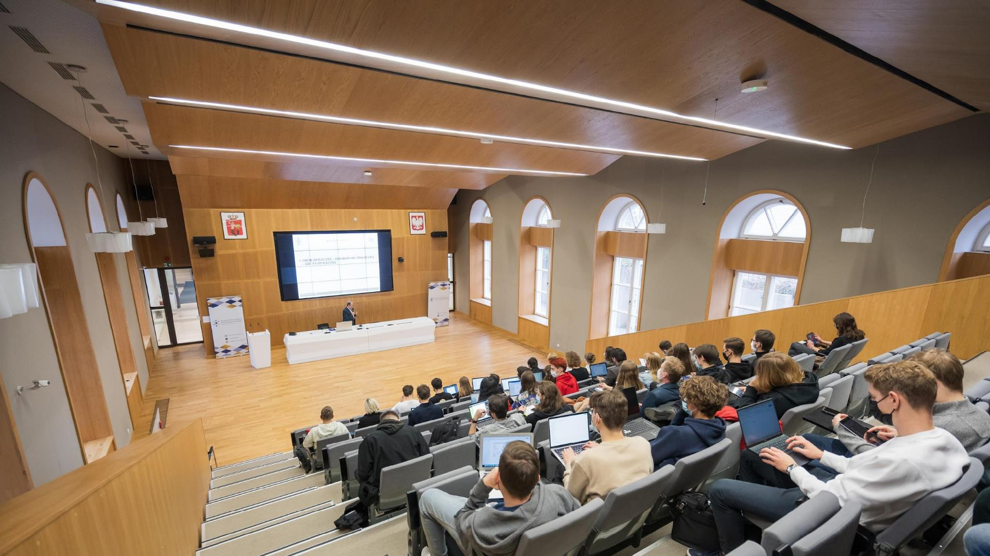
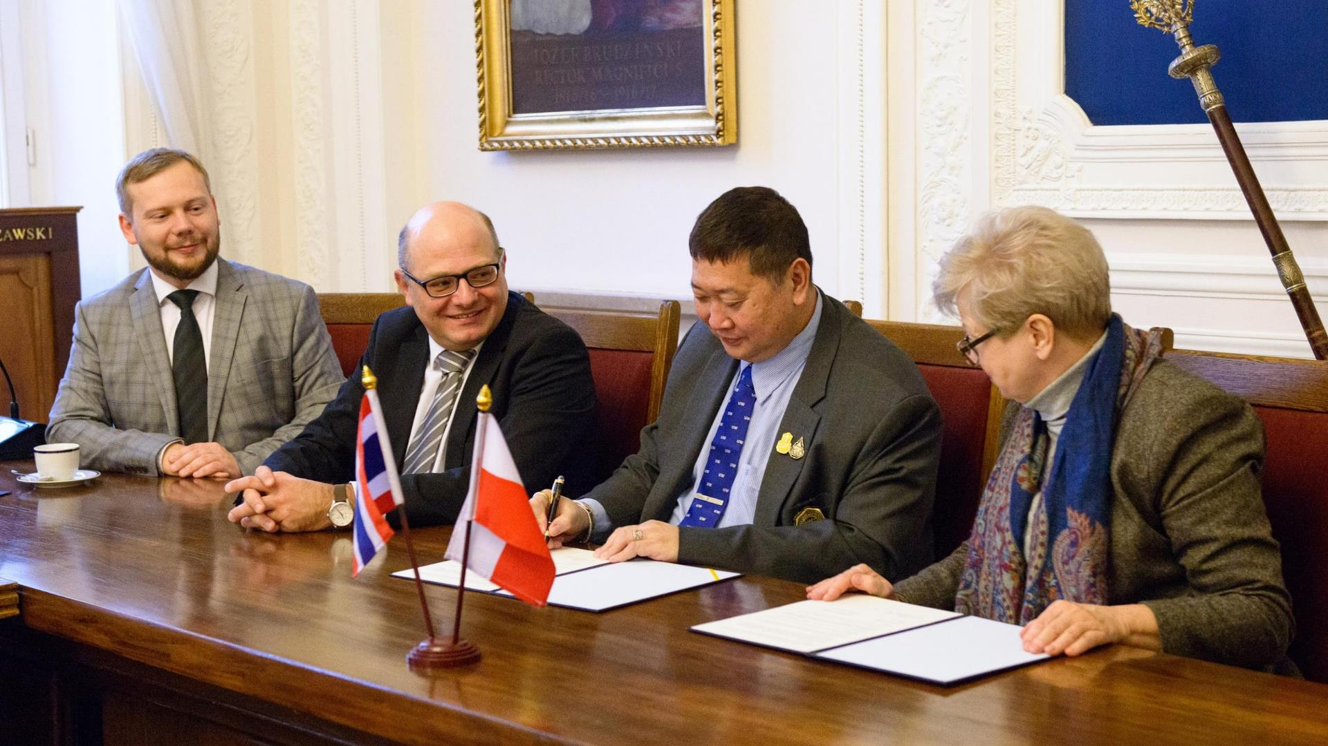
International Cooperation
130 Erasmus+ Agreements
25 Bilateral Agreements
400+ Foreign Students
200+ Scholars

Slide 10
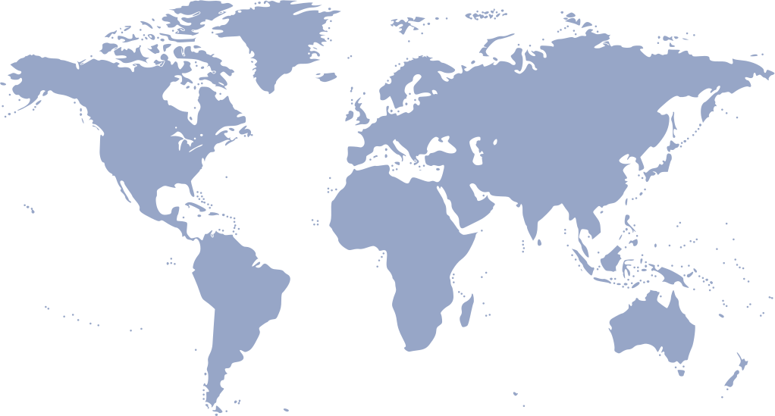
We believe that international experience adds much value to science
and teaching. International partnerships and the exchange of ideas
with foreign universities and institutions are our highest priority.
We are leading the internationalization process at the University of Warsaw.
Our Faculty has over 200 agreements - one of the richest offers of available exchange in this part of Europe!

Slide 11
Best spaces
to study & work

Slide 12
One of the most beautiful libraries in Europe
With unique rooftop gardens

Slide 13
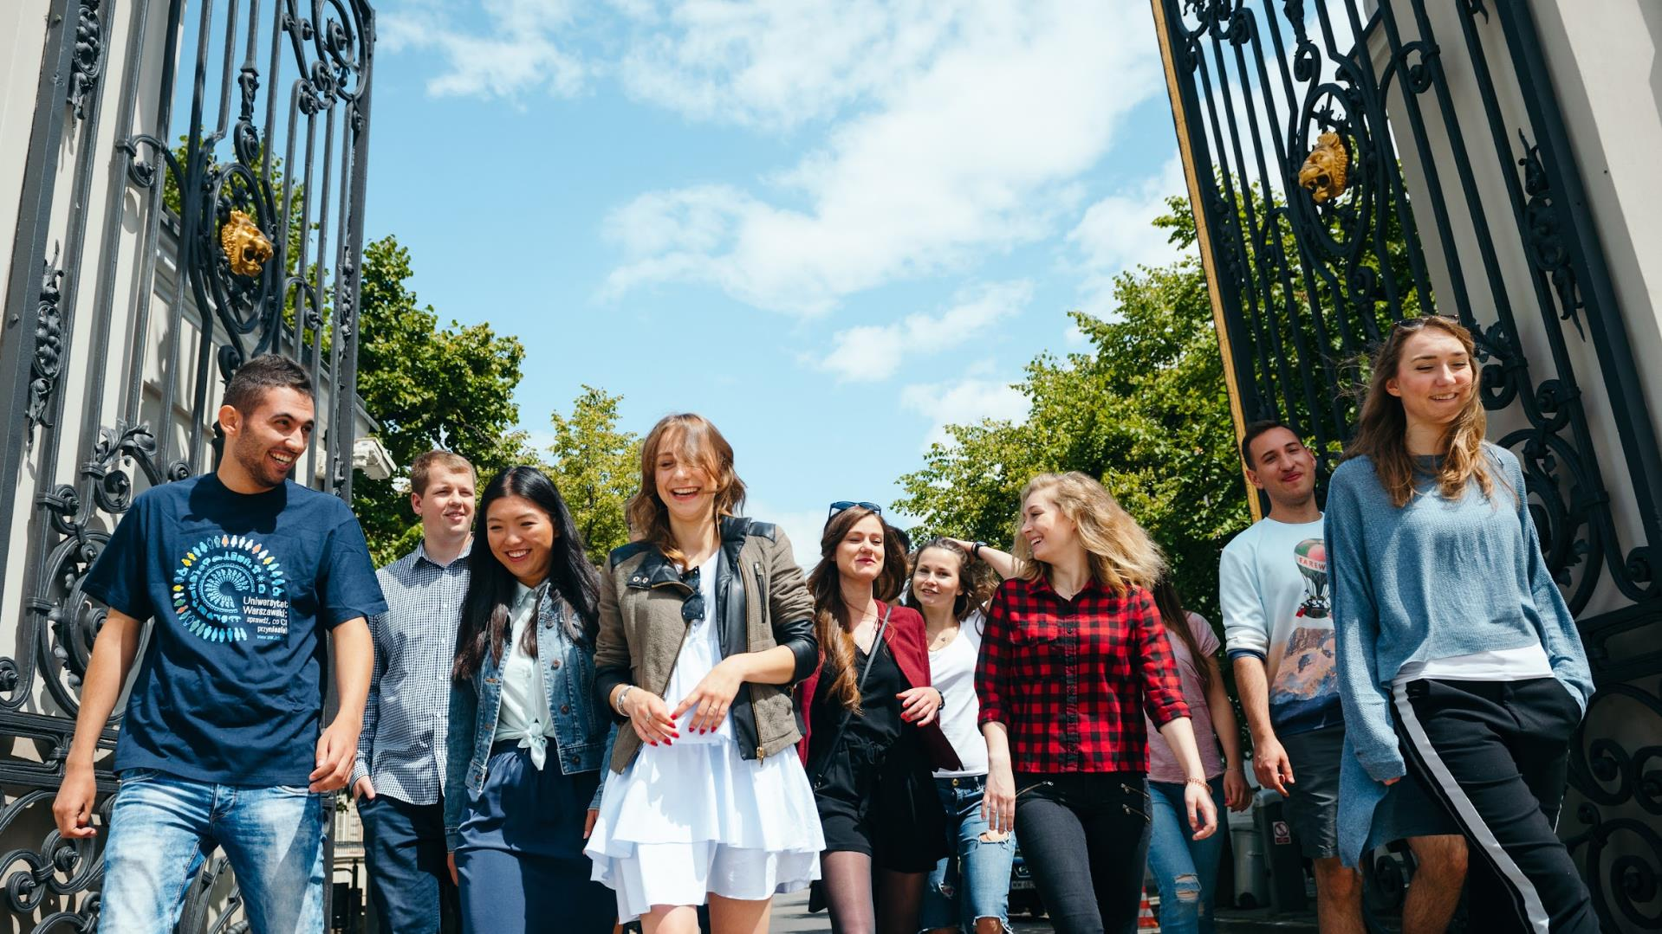
Full-time Programmes
in English
Undergraduate Programme in Political Science
Undergraduate Programme in International Relations
European Politics and Economics
Graduate Programme in International Relations
Graduate Programme in Political Science

Slide 14
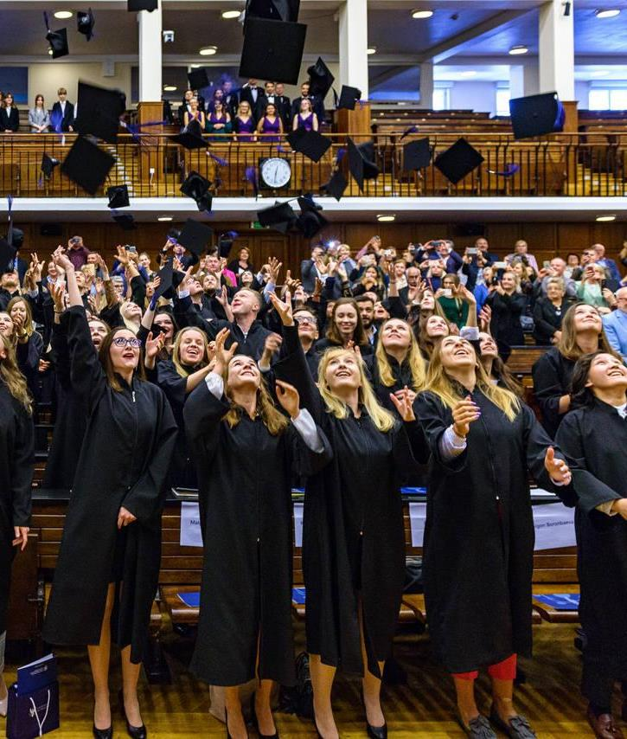
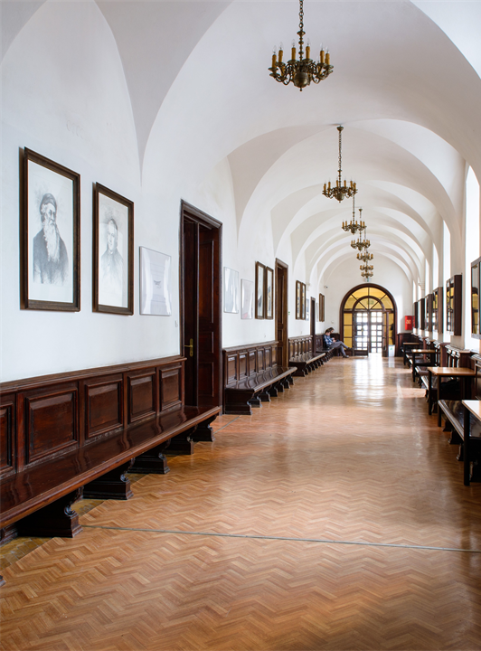
About the programmes:
3-year first-cycle (BA)
2-year second-cycle (MA)
The tuition fee is 3 400 EUR/per year
Fully English-speaking programmes
Selected students can complete a part of the studies abroad thanks to the Erasmus+ exchange
Opportunity to get a double diploma
(e.g. Kyungpook National University)
Lectures and workshops with visiting professors
(e.g. University of Oxford, Heidelberg University, University
of Chicago, Fudan University, Sichuan University, University
of Haifa, Cornell University)

Slide 15
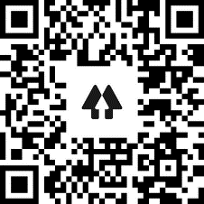
See You at the University of Warsaw!
/ wnpism
www.wnpism.uw.edu.pl/en
www.admission.wnpism.uw.edu.pl
www.cooperation.wnpism.uw.edu.pl

